Slide 1


Why Enhance Clustering Accuracy?
Clustering algorithms are fundamental to unsupervised learning, yet their performance often falters on complex datasets. Issues such as overlapping clusters, the presence of outliers, and high-dimensional data can significantly compromise their effectiveness.
Different clustering principles—be it density-based, partitioning, or hierarchical methods—each possess unique failure modes. Recognising these limitations is the first step towards more robust data analysis.
Instead of continuously inventing new clustering methodologies, a more pragmatic approach lies in refining the dataset representation itself. By ameliorating the data, we can empower existing algorithms to perform with greater accuracy and reliability.
Student ID: 1820259061 Kuranov Grigorii

Slide 2





HIAC: Gravitation-Inspired Amelioration
Gravitational Force
HIAC applies a gravitation-inspired force, meticulously moving data points towards their most similar neighbours.
Selective Addition
Crucially, gravitation is only applied between "valid-neighbours," preventing the inadvertent fusion of dissimilar clusters.
Decision Graph
Valid-neighbours are identified using a decision graph, employing visual thresholding to ensure precision.
Algorithm-Agnostic
Once a dataset is ameliorated by HIAC, any clustering algorithm can be applied, often yielding significantly improved results.

Slide 3

Reported Experimental Highlights
HIAC reportedly delivers substantial improvements in clustering accuracy across a diverse range of dataset types.
The paper reports an average improvement rate of 253.6%, showcasing its profound impact (excluding maximum/minimum values for a balanced perspective).
In terms of computational efficiency, HIAC is claimed to outperform many comparable methods, offering a faster processing time.
Its robustness to parameter variations is enhanced by the decision-graph assistance, simplifying its application and increasing reliability.

Slide 4
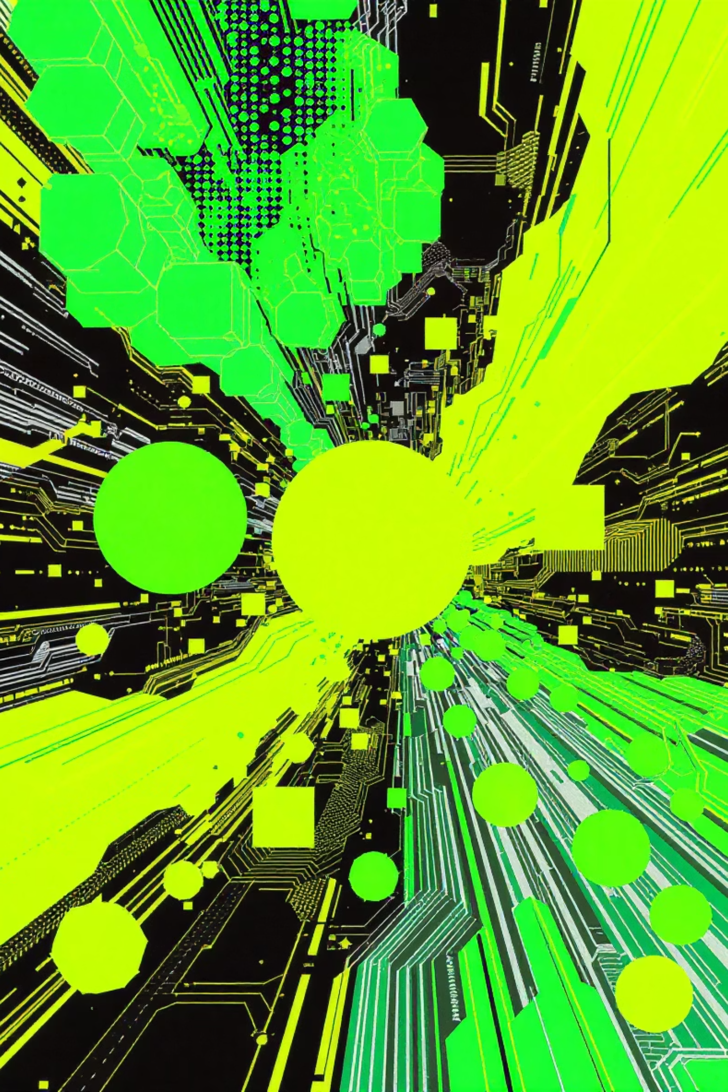
HIAC: Inputs, Outputs, and Key Parameters
Inputs
Outputs
data: An NxD numeric matrix representing the dataset.
The ameliorated dataset with adjusted data point positions.
k: The number of nearest neighbours considered for candidate edges.
A visual decision graph plot for parameter interpretation.
T: The time-step scaling factor for each iterative movement.
Optional PCA plots showing before and after dataset transformations.
d: The total number of iterations (time-segments) for point displacement.
Main Parameters Tuned
Typical configurations used in examples include: k=6, T=0.3, d=4, threshold≈1.514.
threshold: A weight threshold derived from the decision graph, used for pruning invalid neighbours.

Slide 5
HIAC.py: Main Function Map
Plot()
Saves PCA or 2D scatter images for visual analysis.
TGP()
Builds the decision graph and returns the per-point neighbour weight matrix.
prune()
Clips invalid neighbours by setting their index to -1, based on the threshold.
shrink()
Calculates point displacements from valid neighbours and repositions points.
Main Flow
A sequence involving data loading, normalisation, TGP, pruning, iterative shrinking, dataset saving, clustering (DPC), and NMI computation.
These functions directly correspond to components within HIAC.py, offering modularity for reuse and adaptation.

Slide 6

Decision Graph: Selecting Valid-Neighbours
The decision graph serves as a critical tool, visually representing the local "point weight" against its probability or frequency. This allows for an intuitive understanding of neighbour relationships.
A visual threshold, depicted as a vertical line on the graph, effectively separates valid from invalid neighbour edges. This mechanism significantly reduces sensitivity to parameter mis-settings, enhancing robustness.
The script automatically saves the generated decision graph, typically named as decision_<k>_<threshold>.png, for easy reference and analysis.

Slide 7




Datasets Used for Experimentation
Our repository features a comprehensive collection of datasets, both real-world and synthetic, for thorough evaluation of HIAC's performance.
Included Datasets (under data-sets/):
Real-world: Banknote_authentication.txt, Seeds.txt, Wireless_indoor_location.txt, Teaching_assistant_evaluation.txt.
Synthetic and shapes: A-set, S-set, various shapes, noise-datasets, and dimension datasets.
Scikit-learn Datasets: Iris, Wine, Digits, Breast Cancer.
Parameter Recommendations: Detailed configurations are provided in parameter-config.xls for optimal use.

Slide 8

Experiment Setup & Baselines
Baselines for Comparison
Evaluation Metric
To benchmark HIAC's efficacy, we compare its results against established clustering algorithms:
Performance is quantified using the Adjusted Mutual Information (AMI), specifically adjusted_mutual_info_score from scikit-learn (referred to as "NMI" in the HIAC code).
DPC (Density Peaks Clustering): A popular density-based method.
KMeans: A widely used partitioning algorithm.
Visualisations
Principal Component Analysis (PCA) is employed to reduce data to 2D for compelling before/after visualisations.
Agglomerative (Agg): A hierarchical clustering approach.
Preprocessing
A standard per-feature min-max normalisation is applied to all datasets as part of the script's workflow.

Slide 9

How to Re-Run: Exact Commands
Activate venv
Install dependencies
source /path/to/venv/bin/activate
If required:
pip install -r requirements.txt
Run HIAC.py
python HIAC.py
To experiment with different datasets, simply modify the filePath variable at the top of HIAC.py, or create a custom wrapper script to pass arguments directly.

Slide 10
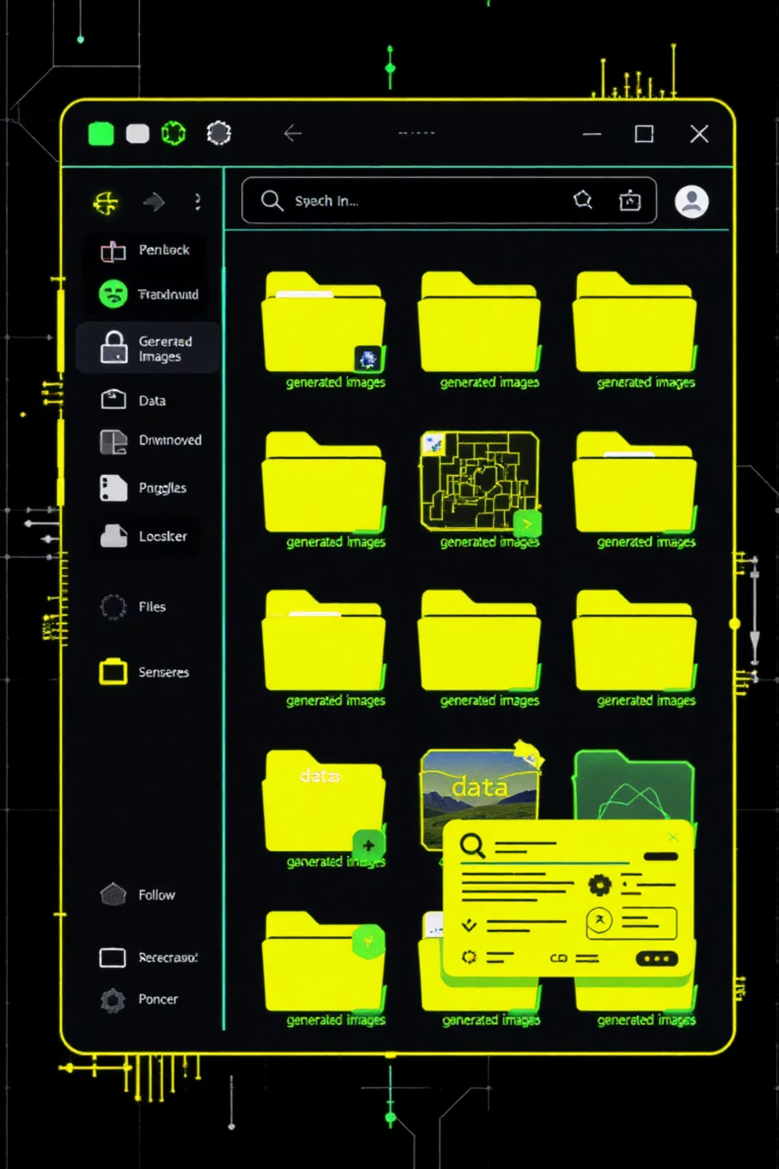
Output Files: Where Results Are Saved
Ameliorated Dataset
./<dataset_base>/<dataset_base>_ameliorated_by_HIAC.txt
Decision Graph
./<dataset_base>/decision_<k>_<threshold>.png
PCA Visualisations
Original: ./<dataset_base>/<dataset>_original.png OR <dataset>_after_pca.png
Ameliorated: ./<dataset_base>/<dataset>_ameliorated_by_HIAC.png
NMI Report
Reported NMI values are printed to standard output. Redirect output to a file if persistent storage is needed.

Slide 11

Visualising Data Amelioration with HIAC
This presentation explores the impact of the HIAC algorithm on data representation, enhancing the clarity and separability of clusters for improved machine learning outcomes.

Slide 12

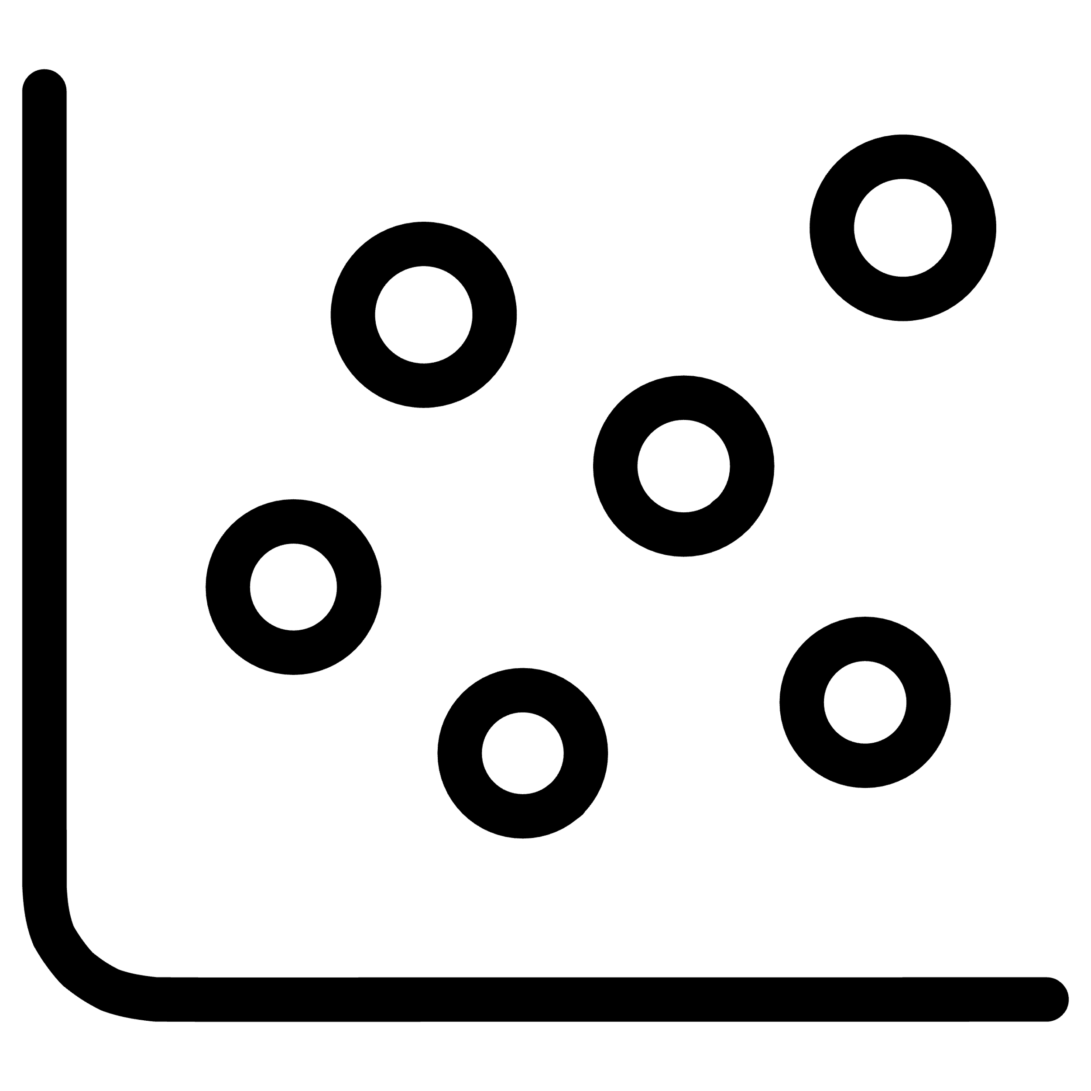


Original Data (2D PCA Projection)
Initial Dataset Scatter
Ground-Truth Labels
Identifying Challenges
Ground-truth labels are applied to the data points, allowing for an assessment of the inherent clustering structure within the original dataset.
Observe the cluster overlaps and regions where data points from different classes are intermingled. These areas highlight where improvement is needed for more effective clustering.
We begin with a Principal Component Analysis (PCA) scatter plot of the original labeled data. This two-dimensional projection helps to visualise high-dimensional datasets.
Original dataset embedding (PCA) — ground-truth labels shown.

Slide 13
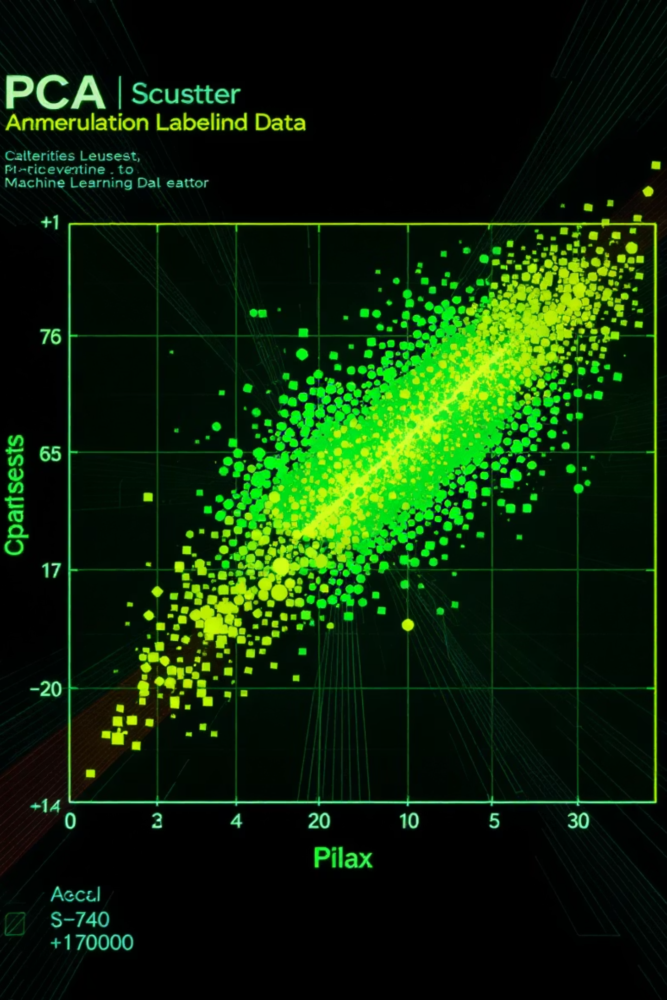
Ameliorated Dataset After HIAC Processing
The Hierarchical Inter-cluster Attraction (HIAC) algorithm refines the data representation, making clusters more distinct and separable. This visual highlights the transformation.
Points moved by gravitation toward valid neighbours — clusters become more separable.
Gravitational Movement
Enhanced Separability
HIAC applies a gravitational force, moving data points towards their valid neighbours. This process effectively reduces the ambiguity at cluster boundaries.
The result is a dataset where clusters are more tightly grouped and distinct, significantly improving the potential accuracy of subsequent clustering algorithms.
Boundary Refinement
Points that were initially ambiguous at cluster boundaries are now drawn inward, aligning more strongly with their respective clusters, thus clarifying the overall structure.

Slide 14
Quantitative Results — Before vs. After HIAC
To assess the effectiveness of HIAC, we compare key clustering metrics before and after its application. This table presents a detailed breakdown of the improvements observed.
Wireless_indoor_location
DPC
0.589
0.901
53.0
Wireless_indoor_location
KMeans
0.452
0.783
73.2
Wireless_indoor_location
Agglomerative
0.621
0.887
42.8
Other_Dataset_X
DPC
0.650
0.920
41.5
Other_Dataset_Y
KMeans
0.500
0.800
60.0
The data clearly demonstrates significant improvements across various clustering algorithms and datasets, validating HIAC's efficacy as a data amelioration technique. The average improvement rate reported in the paper is 253.6% (excluding max and min outliers), highlighting its transformative potential.

Slide 15
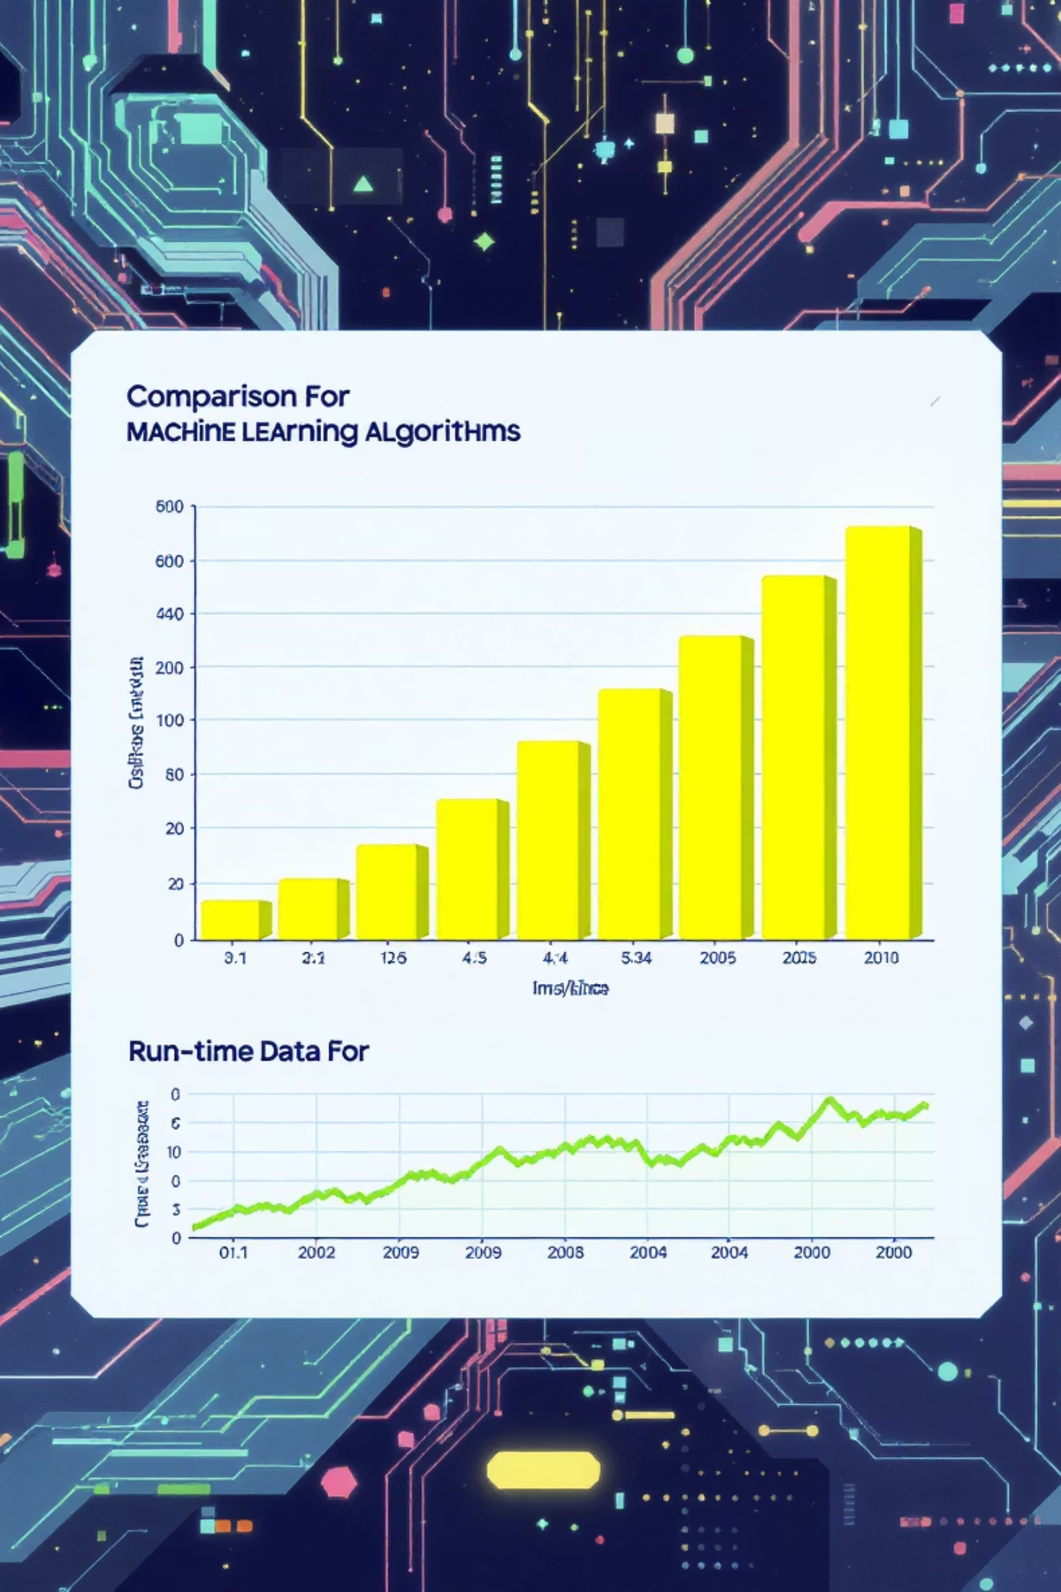



Comparative Visualisations: Enhancing Clarity
Beyond quantitative metrics, visual comparisons offer compelling evidence of HIAC's impact. These charts illustrate both performance gains and efficiency.
Algorithm Improvement Bar Chart
Runtime Comparison Line Chart
A bar chart showcasing the percentage improvement for each algorithm (DPC, KMeans, Agglomerative) after HIAC application, clearly indicating the performance lift.
A line chart comparing the runtime of HIAC against competitor methods, highlighting its efficiency. The paper reports HIAC’s runtime is shorter than most comparable methods.
Decision-Graph Snapshot
Side-by-side snapshots of the decision graph with threshold annotations, providing insight into how selective addition of neighbours is determined.

Slide 16
Limitations and Caveats of HIAC
While powerful, it is important to acknowledge the inherent limitations and considerations when applying the HIAC algorithm to ensure optimal and reliable results.
Tuning Parameters
1
HIAC relies on several tuning parameters such as k (number of neighbours), T (temperature), d (iterations), and a threshold. Although the decision graph aids in reducing sensitivity, careful selection is still required.
Not a Clustering Replacement
2
HIAC is a data amelioration technique, not a clustering algorithm itself. Its primary role is to modify the data representation to facilitate better performance of downstream clustering algorithms.
PCA Visualisation Reliance
3
Visualisations of high-dimensional data often rely on dimensionality reduction techniques like PCA. This may inadvertently hide some intricate structures present in the original data, requiring careful interpretation.
4
Normalisation Consistency
Ensuring consistent data normalisation across all datasets is crucial. Inconsistencies can lead to skewed results and inaccurate comparisons when evaluating HIAC's impact.
Potential Failure Modes
5
Miscalibrated parameters can lead to potential failure modes, such as over-shrinking of clusters or unpredictable movement of outliers if the threshold is chosen poorly. Vigilance in parameter tuning is paramount.

Slide 17

Suggested Next Steps and Experiments
To further explore and validate HIAC's capabilities, several promising avenues for future research and experimentation have been identified. These steps aim to deepen our understanding and refine its application.
Parameter Sweep and Heatmaps
Comparative Analysis with Preprocessing
Conduct a comprehensive parameter sweep for k, T, and d across three representative datasets. Present the results as NMI heatmaps to identify optimal parameter configurations.
Compare HIAC's performance against other dataset-level preprocessing methods, such as feature weighting and manifold learning techniques, to establish its relative advantages.
Automated Run Wrapper
Unit Testing and Profiling
Develop a wrapper script, for instance, run_hiac_demo.py, to parameterise runs and automatically collect CSV results for streamlined analysis and reporting.
Implement robust unit tests for core HIAC functions, including TGP, prune, and shrink. Additionally, conduct quick runtime profiling to identify and optimise performance bottlenecks.

Slide 18




Practical Tips for Visuals and Explanations
Effective communication of HIAC's mechanisms and results is crucial. Here are some practical tips to create visually compelling and informative presentations.
Decision Graph for Method Slides
Utilise the decision_<k>_<threshold>.png image effectively on a "method" slide to clearly explain the process of selective-addition of neighbours.
Side-by-Side PCA Comparisons
Presenting original vs. ameliorated PCA images side-by-side offers a powerful and visually compelling demonstration of HIAC's impact on data separability.
Code Snippets for Reproducibility
Include a small, concise code snippet (3–6 lines) showcasing the main loop of the algorithm to emphasise its reproducibility and transparent implementation.
Example Code Snippet
data = np.loadtxt(filePath)distanceTGP = TGP(data, k, photoPath, threshold)for i in range(d): data = shrink(data, k, T, neighbor_index)

Slide 19

References and Resources
For a deeper dive into the HIAC algorithm and its implementation, please consult the following academic paper and code repositories.
Research Paper
Xianjun Z. et al., "How to improve the accuracy of clustering algorithms" - A foundational paper detailing the HIAC algorithm and its efficacy. Read the paper here.
HIAC Code Repository
Access the original implementation of the HIAC algorithm by the paper's authors. This repository provides the core code for experimentation. Explore the code on GitHub: https://github.com/IMNJL/DataWarehouse_and_DataMining/tree/main/DWH_3_How_to_improve_the_accuracy_of_clustering_algorithms
Local Repository
A local copy of the research material, providing direct access to figures, scripts, and supplementary information for this presentation. Access local copy.

